Slide 1

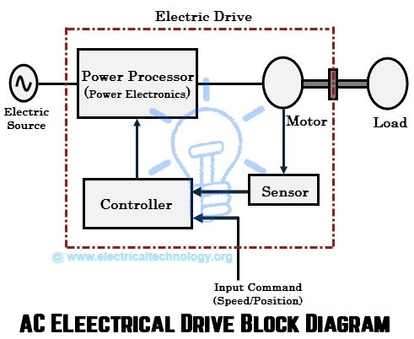
EE216 Electrical Engineering
Dr. Unnikrishnan P.C.
Professor, EEE

Slide 2
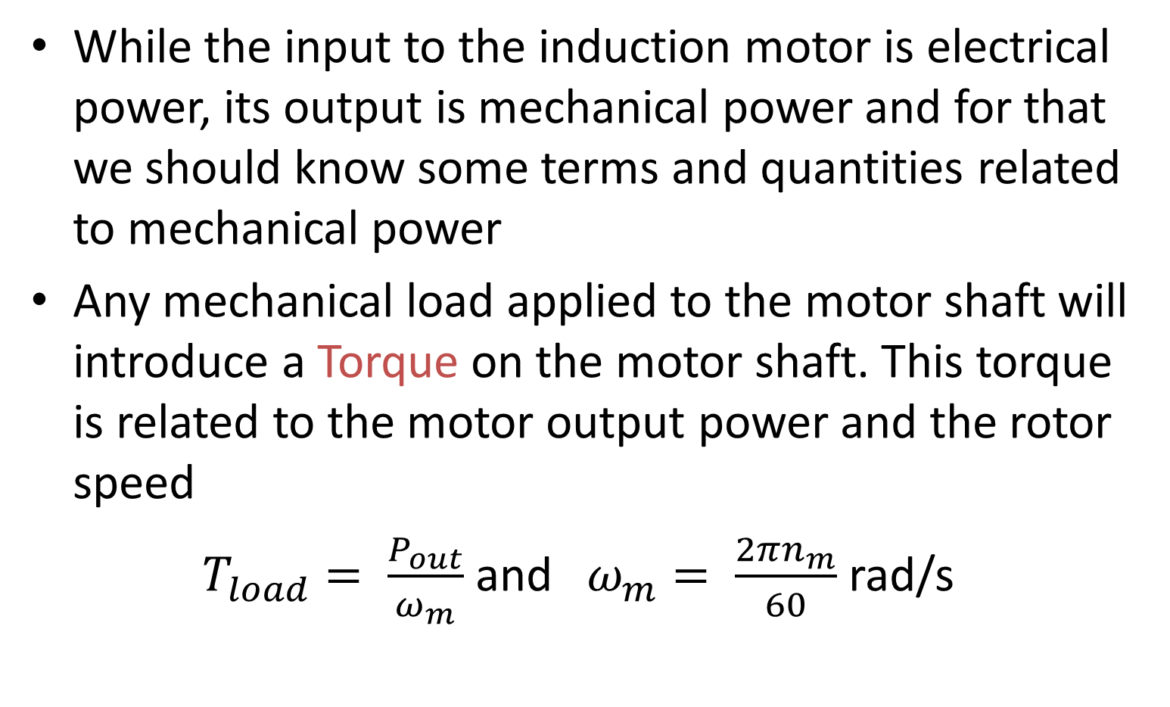
Torque
While the input to the induction motor is electrical power, its output is mechanical power and for that we should know some terms and quantities related to mechanical power
Any mechanical load applied to the motor shaft will introduce a Torque on the motor shaft. This torque is related to the motor output power and the rotor speed
$T_{load}= \frac{P_{out}}{ω_{m}}$ and $ω_{m}= \frac{2πn_{m}}{60}$rad/s

Slide 3
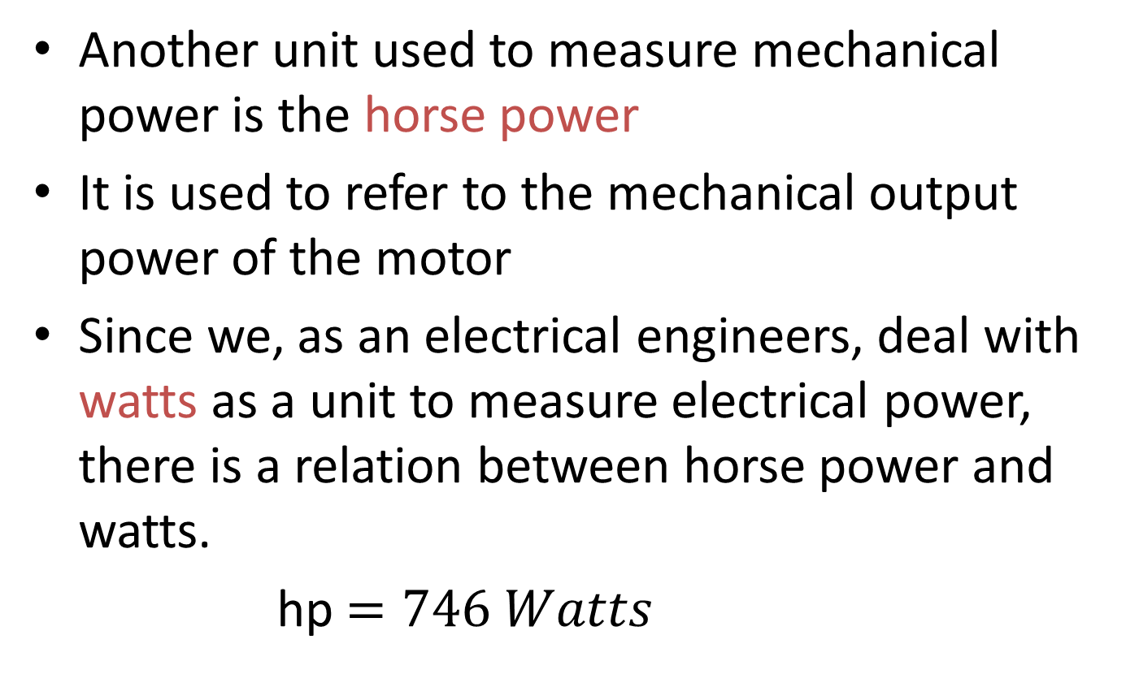
Horse Power
Another unit used to measure mechanical power is the horse power
It is used to refer to the mechanical output power of the motor
Since we, as an electrical engineers, deal with watts as a unit to measure electrical power, there is a relation between horse power and watts.
hp$=746 Watts$

Slide 4
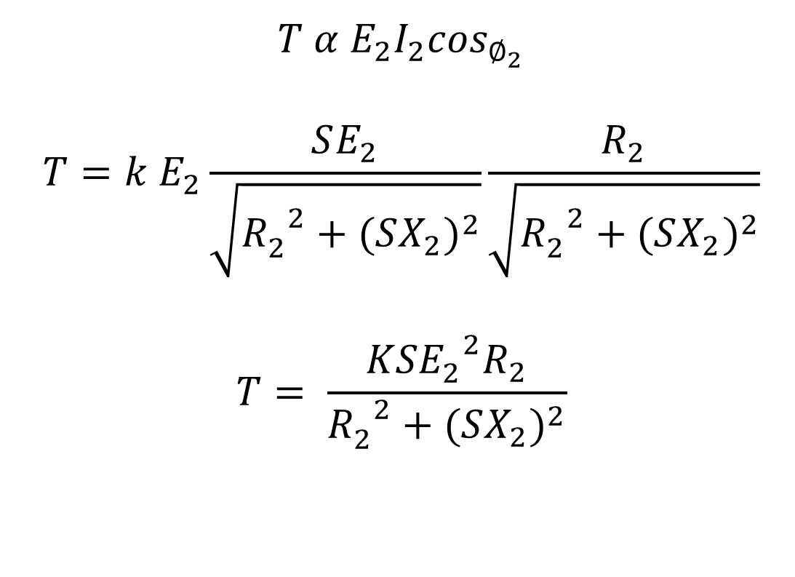
Torque-Slip Equation
$$T α E_{2}I_{2}\cos_{∅_{2}}$$
$$T=k E_{2}\frac{SE_{2}}{\sqrt{{R_{2}^{}}^{2}+{(SX_{2})}^{2}}}\frac{R_{2}}{\sqrt{{R_{2}^{}}^{2}+{(SX_{2})}^{2}}}$$
$$T= \frac{KS{E_{2}^{}}^{2}R_{2}}{{R_{2}^{}}^{2}+{(SX_{2})}^{2}}$$

Slide 5
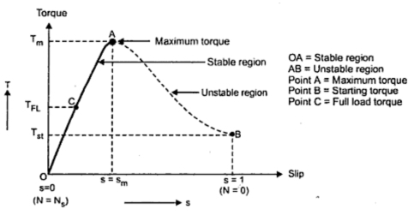
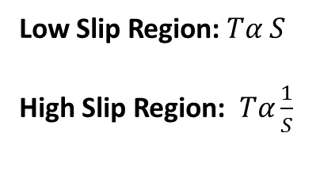
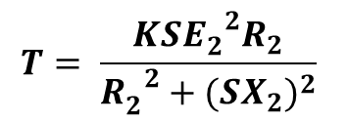
Torque-Slip Characteristics
$$T= \frac{KS{E_{2}^{}}^{2}R_{2}}{{R_{2}^{}}^{2}+{(SX_{2})}^{2}}$$
Low Slip Region: $Tα S$
High Slip Region: $Tα\frac{1}{S}$

Slide 6
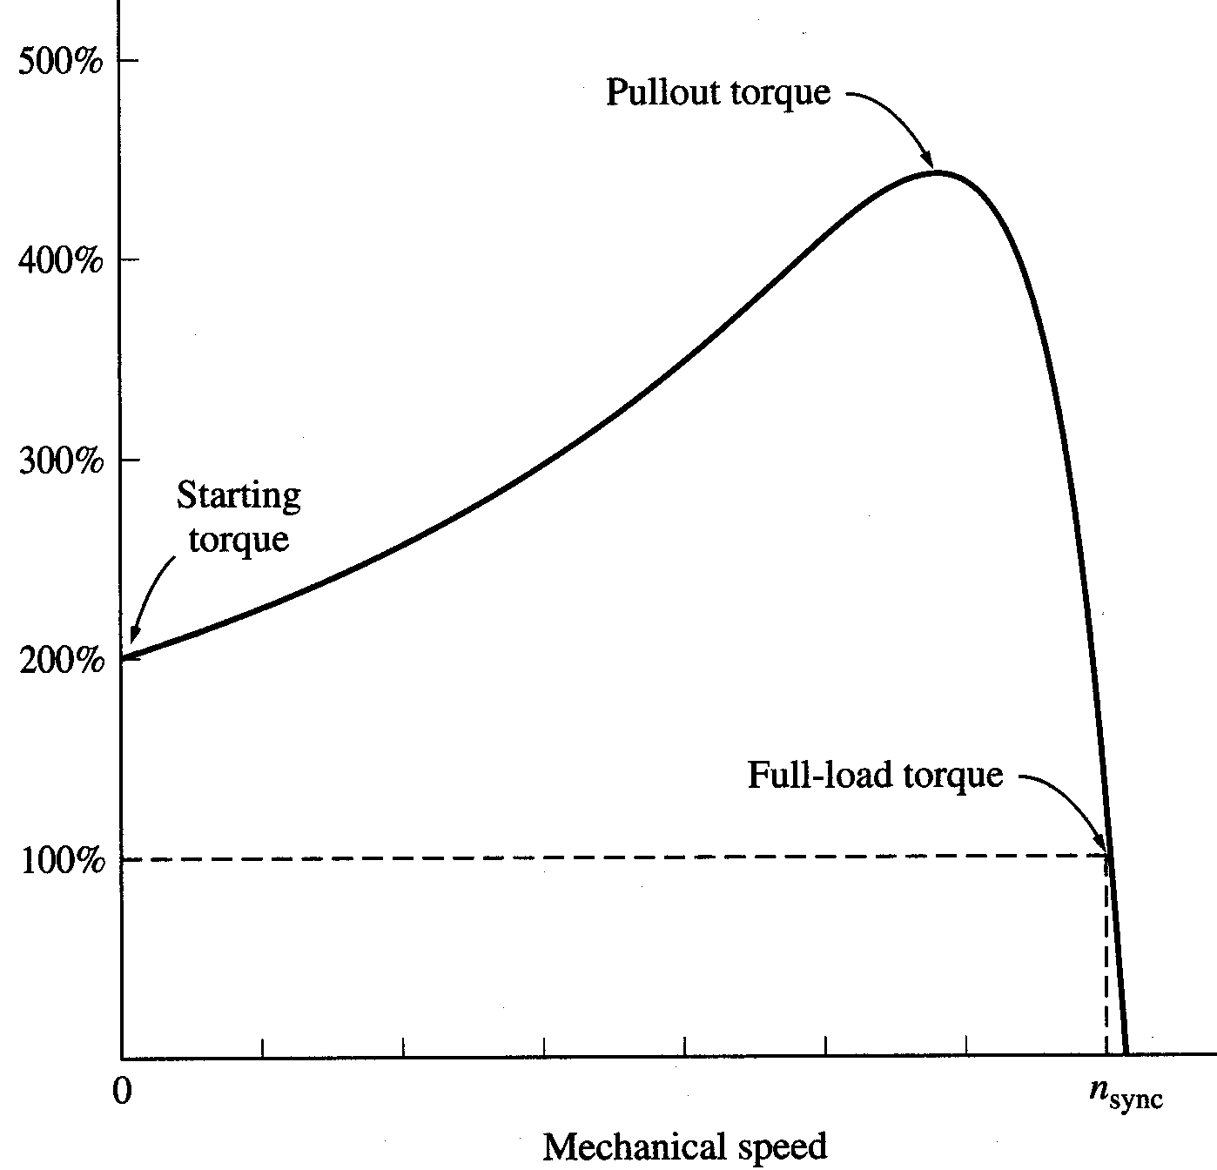
Torque-speed characteristics
Typical torque-speed characteristics of induction motor

Slide 7
Power losses in Induction Machines
Copper losses
  Copper loss in the stator (P_{SCL}) = I₁²R₁
  Copper loss in the rotor (P_{RCL}) = I₂²R₂
Core loss (P_{core})
Mechanical power loss due to friction and windage
How this power flow in the motor?

Slide 8
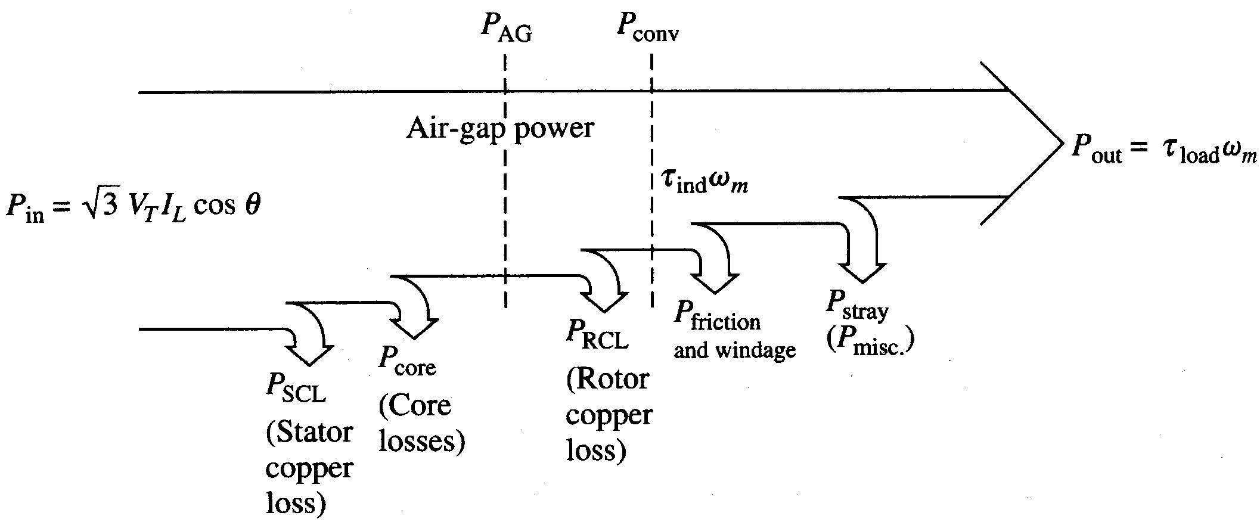
Power Flow in Induction Motor

Slide 9



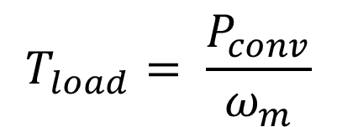
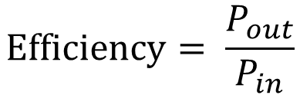
Power Relations
$$P_{SCL}−Stator Copper Loss$$
$$P_{AG}−Air Gap Power$$
$$P_{RCL}−Rotor Copper Loss$$
$${,P}_{conv}−The Electrical Power converted to mechacical$$
$$T_{load}= \frac{P_{conv}}{ω_{m}}$$
$$Efficiency= \frac{P_{out}}{P_{in}}$$

Slide 10
Induction Generator
Suppose that an induction machine is coupled with the prime mover whose speed can be controlled.
If the speed of the prime mover is increased such that the slip becomes negative
As Slip becomes negative, the rotor current and rotor emf attains negative value.
The prime mover torque becomes opposite to electric torque.

Slide 11
Induction Generator ……
Induction generators are often used in wind turbines and some micro hydro installations due to their ability to produce useful power at varying rotor speeds.
Induction generators are mechanically and electrically simpler than other generator types.
They are also more rugged, requiring no brushes or commutators.

Slide 12
Example
A 208-V, 10hp, four pole, 60 Hz, Y-connected induction motor has a full-load slip of 5 percent
  What is the synchronous speed of this motor?
  What is the rotor speed of this motor at rated load?
  What is the rotor frequency of this motor at rated load?
  What is the shaft torque of this motor at rated load?

Slide 13
Solution

Slide 14
Example
A 480-V, 60 Hz, 50-hp, three phase induction motor is drawing 60A at 0.85 PF lagging. The stator copper losses are 2 kW, and the rotor copper losses are 700 W. The friction and windage losses are 600 W, the core losses are 1800 W, and the stray losses are negligible. Find the following quantities:
  The air-gap power P_{AG.}
  The power converted P_{conv}.
  The output power P_{out}.
  The efficiency of the motor.

Slide 15
Solution

Slide 16
Solution

Slide 17
Example
  A two-pole, 50-Hz induction motor supplies 15kW to a load at a speed of 2950 rpm.
  What is the motor’s slip?
  What is the induced torque in the motor in N.m under these conditions?
  What will be the operating speed of the motor if its torque is doubled?
  How much power will be supplied by the motor when the torque is doubled?

Slide 18
Solution

Slide 19
Solution
  In the low-slip region, the torque-speed curve is linear and the induced torque is direct proportional to slip. So, if the torque is doubled the new slip will be 3.33% and the motor speed will be

Slide 20
Question?
Q: How to change the direction of rotation?
A: Change the phase sequence of the power supply.

Slide 21
Question?
Q: Why rotor core loss in a three phase induction motor negligible?
A: Usually we operate motor at slip in the range 0.04 ~ 0.06, thus for a stator frequency of 50 Hz , rotor frequency is around 2~3 Hz. As core losses are proportional to square of frequency (Eddy current losses) or proportional to frequency ( Hysteresis losses) , therefore the value of the Core loss is negligible for rotor.

