Slide 1

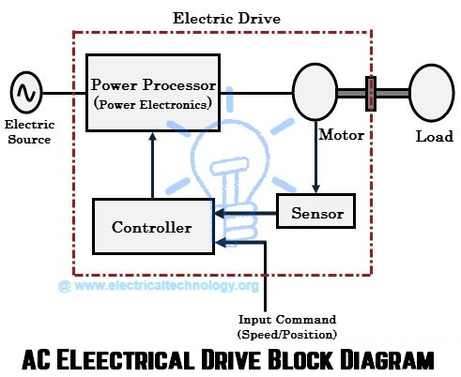
EC010504(EE) Electric Drives & Control
Dr. Unnikrishnan P.C.
Professor, EEE

Slide 2

Module I
DC Generator $√$
DC Motor

Slide 3
DC Motors
Converts Electrical energy into Mechanical energy
Construction : Same for Generator and motor
Working principle : Whenever a current carrying conductor is placed in the magnetic field , a force is set up on the conductor.

Slide 4
Equivalent Circuit of a DC Machine
I_{f}
I_{a_gen}
I_{f}
+
I_{L}
+
I_{a_mot}
+
R_{a}
R_{a}
V_{f}
R_{f}
V_{t}
R_{f}
V_{t}
+
-
E_{a}
-
E_{a}
I_{a}
-
+
-

Slide 5
Back emf
The induced emf in the rotating armature conductors always acts in the opposite direction of the supply voltage .
According to the Lenz’s law, the direction of the induced emf is always so as to oppose the cause producing it .
In a DC motor , the supply voltage is the cause and hence this induced emf opposes the supply voltage.

Slide 6
Generated emf and Electromagnetic Torque
Motor: V_{t} > E_{a}
Generator: V_{t} > E_{a}
Voltage generated in the armature circuit due the flux of the stator field current
K_{a}: design constant
Electromagnetic torque

Slide 7
Torque
The turning or twisting force about an axis is called torque .
P = T * 2 πN/ 60
Eb Ia = Ta * 2 πN/ 60
T ∞ φ I a
Ta ∞ I2a

Slide 8
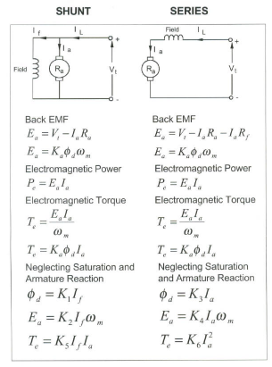
Comparison between the Shunt and Series Connected DC Machines

Slide 9
Types of DC Machines
Both the armature and field circuits carry direct current in the case of a DC machine.
Types:
Self-excited DC machine: when a machine supplies its own excitation of the field windings. In this machine, residual magnetism must be present in the ferromagnetic circuit of the machine in order to start the self-excitation process.
Separately-excited DC machine: The field windings may be separately excited from an eternal DC source.
Shunt Machine: armature and field circuits are connected in parallel. Shunt generator can be separately-excited or self-excited.
Series Machine: armature and field circuits are connected in series.

Slide 10
Separately-Excited and Self-Excited DC Generators
I_{L}
+
I_{L}
+
I_{f}
+
R_{a}
R_{a}
DC Supply
R_{f}
V_{t}
R_{f}
V_{t}
+
E_{a}
E_{a}
-
I_{a}
-
-
Separately-Excited Self-Excited

Slide 11
Characteristic of DC motors
T/ Ia characteristic
N/ I a characteristic
N/T characteristic

Slide 12
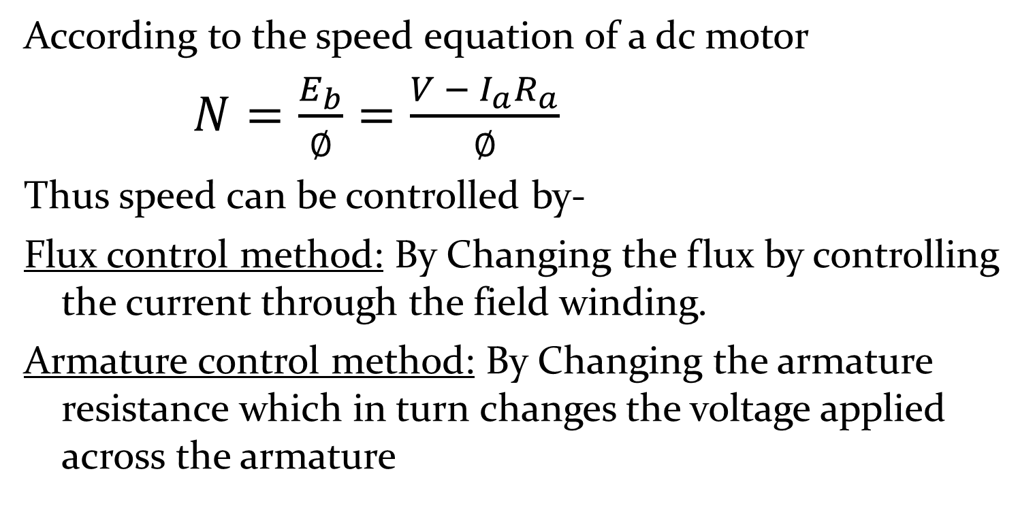
Speed control of DC motors
According to the speed equation of a dc motor
$N=\frac{E_{b}}{∅}=\frac{V − I_{a}R_{a}}{∅}$
Thus speed can be controlled by-
Flux control method: By Changing the flux by controlling the current through the field winding.
Armature control method: By Changing the armature resistance which in turn changes the voltage applied across the armature

Slide 13
Flux control
Advantages of flux control:
It provides relatively smooth and easy control
Speed control above rated speed is possible
As the field winding resistance is high the field current is small. Power loss in the external resistance is small . Hence this method is economical
Disadvantages:
Flux can be increased only upto its rated value
High speed affects the commutation, motor operation becomes unstable

Slide 14
Armature voltage control method
The speed is directly proportional to the voltage applied across the armature .
Voltage across armature can be controlled by adding a variable resistance in series with the armature
Potential divider control :
If the speed control from zero to the rated speed is required , by rheostatic method then the voltage across the armature can be varied by connecting rheostat in a potential divider arrangement .

Slide 15
Starters for DC motors
Needed to limit the starting current .
1. Two point starter
2. Three point starter
3. Four point starter

Slide 16
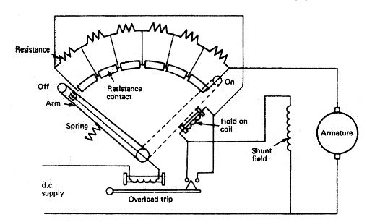
Motor Starter – 3 Point Starter

Slide 17
Testing of DC machines
To determine the efficiency of as DC motor , the output and input should be known.
There are two methods.
The load test or The direct method
The indirect method
Direct method: In this method , the efficiency is determined by knowing the input and output power of the motor.
Indirect method: Swinburne’s test is an indirect method of testing DC shunt machines to predetermine the effficency , as a motor and as a Generator. In this method, efficiency is calculated by determining the losses .

Slide 18
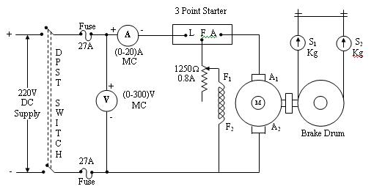
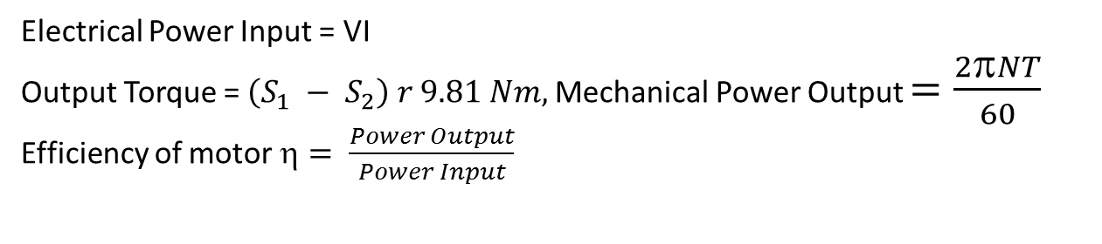
Brake Test
Electrical Power Input = VI
Output Torque = $\left(S_{1} − S_{2}\right) r 9.81 Nm,$Mechanical Power Output $=\frac{2πNT}{60}$
Efficiency of motor $= \frac{Power Output}{Power Input}$

Slide 19
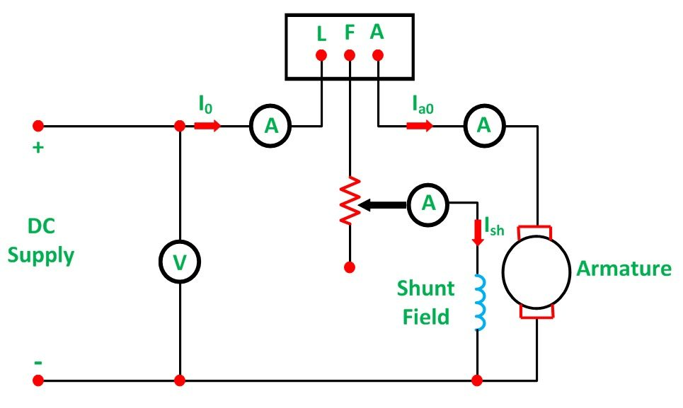
Swinburne Test

Slide 20
Applications:
Shunt Motor:
Blowers and fans
Centrifugal and reciprocating pumps
Lathe machines
Machine tools
Milling machines
Drilling machines

Slide 21
Applications:
Series Motor:
Cranes
Hoists , Elevators
Trolleys
Conveyors
Electric locomotives

Slide 22
Applications:
Cumulative compound Motor:
Rolling mills
Punches
Shears
Heavy planers
Elevators

Slide 23
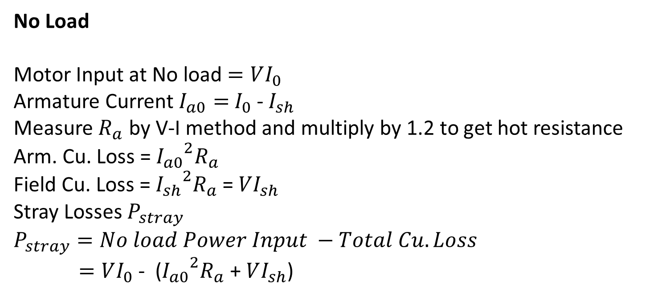
Swinburne Test
No Load
Motor Input at No load $=VI_{0}$
Armature Current $I_{a0}=$ $I_{0}$ - $I_{sh}$
Measure $R_{a}$ by V-I method and multiply by 1.2 to get hot resistance
Arm. Cu. Loss = ${I_{a0}}^{2}R_{a}$
Field Cu. Loss = ${I_{sh}}^{2}R_{a}$ = $VI_{sh}$
Stray Losses $P_{stray}$
$$P_{stray}=No load Power Input −Total Cu. Loss$$
$=VI_{0}$ - (${I_{a0}}^{2}R_{a}$ + $VI_{sh}$)

Slide 24
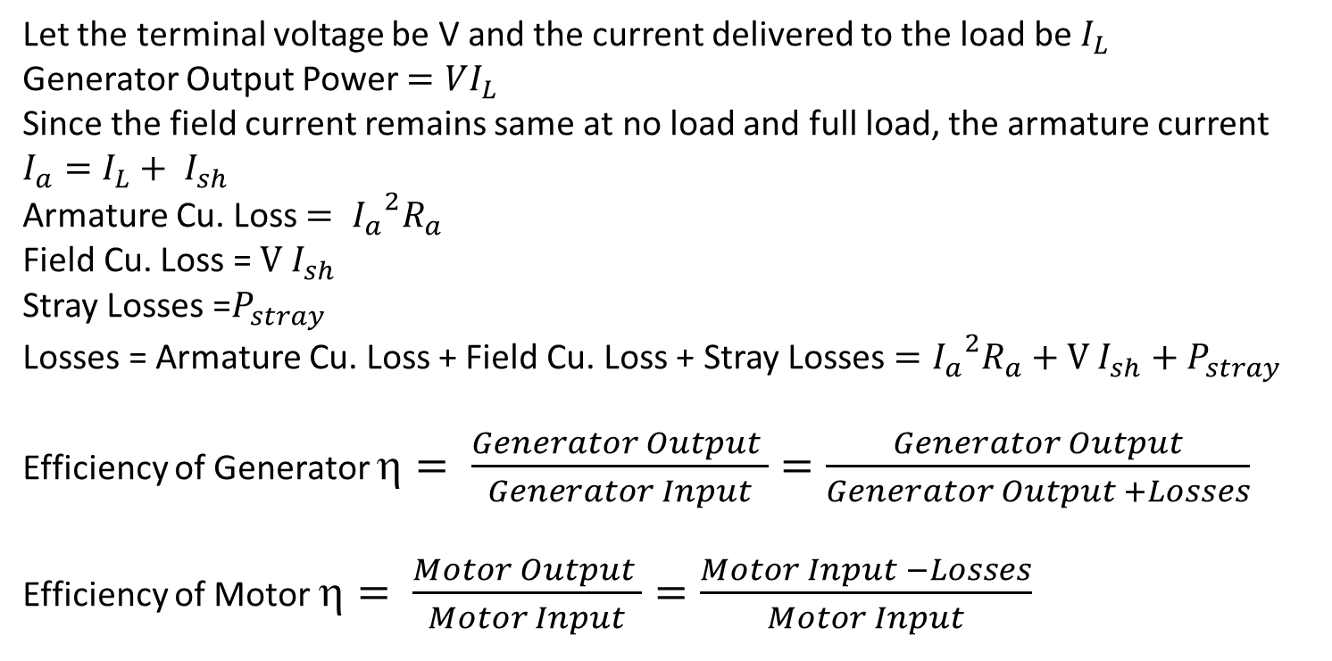
Efficiency of the machine working as a Generator & Motor
Let the terminal voltage be V and the current delivered to the load be $I_{L}$
Generator Output Power $=VI_{L}$
Since the field current remains same at no load and full load, the armature current
$$I_{a}=I_{L}+ I_{sh}$$
Armature Cu. Loss $= {I_{a}}^{2}R_{a}$
Field Cu. Loss = $V I_{sh}$
Stray Losses =$P_{stray}$
Losses = Armature Cu. Loss + Field Cu. Loss + Stray Losses $={I_{a}}^{2}R_{a}+V I_{sh}+P_{stray}$
Efficiency of Generator $= \frac{Generator Output }{Generator Input}=\frac{Generator Output}{Generator Output +Losses}$
Efficiency of Motor $= \frac{Motor Output }{Motor Input}=\frac{Motor Input −Losses}{Motor Input}$

Slide 25
Summary

