Slide 1

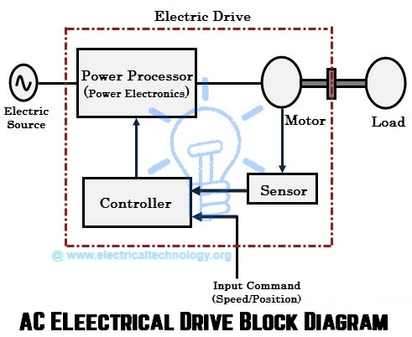
EE216 Electrical Engineering
Dr. Unnikrishnan P.C.
Professor, EEE

Slide 2
Induction Motor
Advantages
  Robust; No brushes. No contacts on rotor shaft
  High Power/Weight ratio compared to DC motor
  Lower Cost/Power
  Easy to manufacture
  Almost maintenance-free, except for bearing and other mechanical parts
  wide range of power ratings: fractional HP to 10 MW

Slide 3
Induction Motor
Disadvantages
  Essentially a “fixed-speed” machine
  Speed is determined by the supply frequency
  To vary its speed need a variable frequency supply

Slide 4
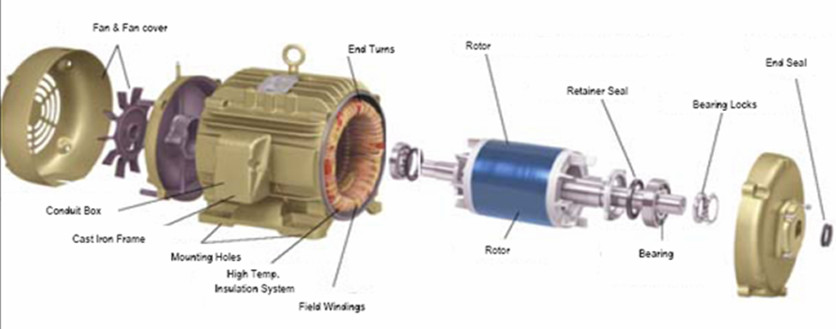
Parts of an Induction Motor

Slide 5
Construction
An induction motor has two main parts
  a stationary stator
    consisting of a steel frame that supports a hollow, cylindrical core
    core, constructed from stacked laminations (why?), having a number of evenly spaced slots, providing the space for the stator winding

Slide 6
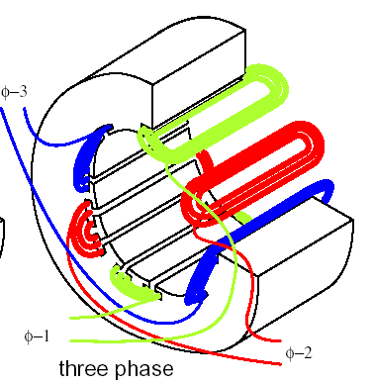
Construction- Stator

Slide 7
Construction-Rotor
Two basic designs
  Squirrel-Cage: conducting copper or aluminium bars laid into slots and shorted at both ends by shorting rings. (Squirrel Cage Induction Motor)
  Wound-Rotor: complete set of three-phase windings exactly as the stator. Usually Y-connected, the ends of the three rotor wires are connected to 3 slip rings on the rotor shaft. In this way, the rotor circuit is accessible. (Slip-Ring Induction Motor)

Slide 8
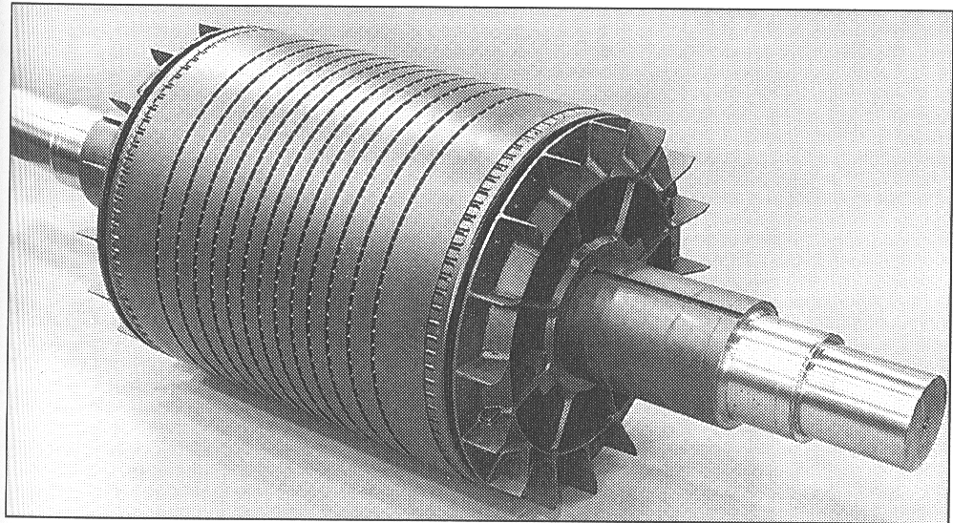
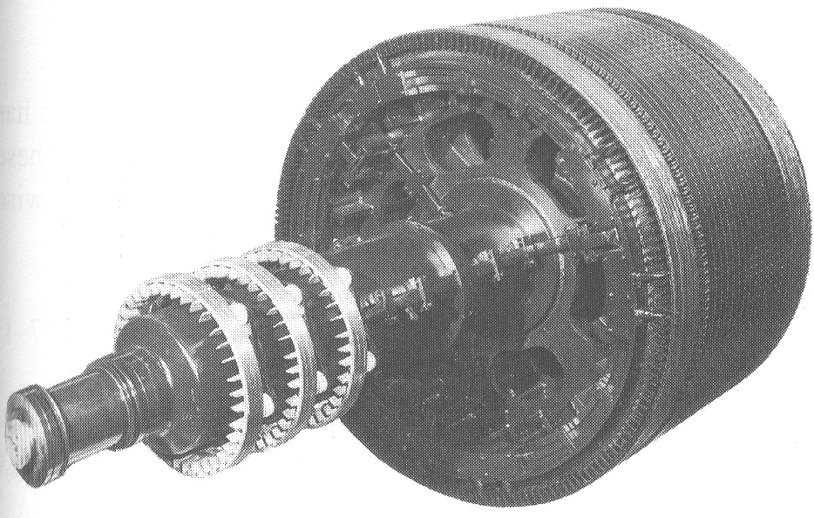
Construction
Squirrel cage rotor
Wound rotor
Notice the slip rings

Slide 9
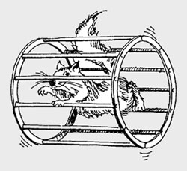
Construction- Rotor (Squirrel Cage)

Slide 10
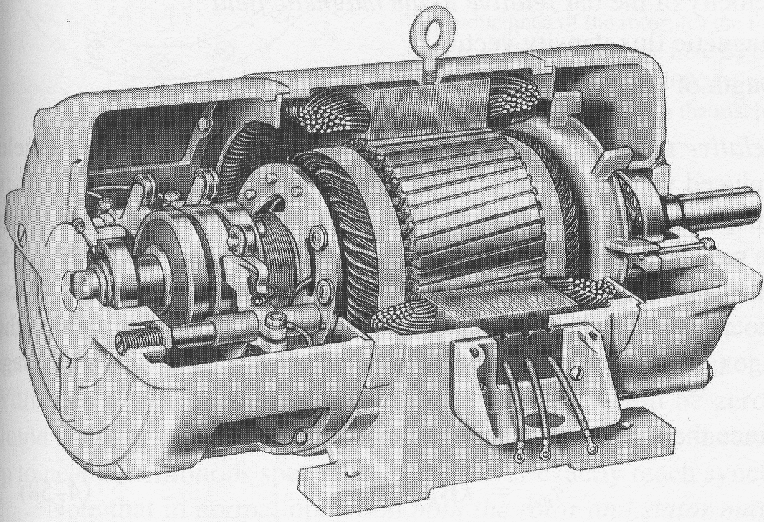
Construction-Wound Rotor
(Slip Ring Induction Motor)
Slip rings
Cutaway in a typical wound-rotor IM. Notice the brushes and the slip rings
Brushes

Slide 11
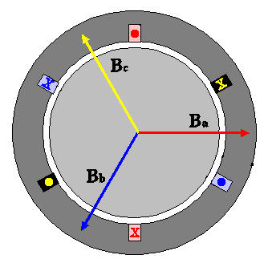
Rotating Magnetic Field
Balanced three phase windings, i.e. mechanically displaced 120 degrees form each other, fed by balanced three phase source
A rotating magnetic field with constant magnitude is produced, rotating with a speed
Where f_{e} is the supply frequency and
P is the no. of poles and N_{s} is called the synchronous speed in rpm

Slide 12
Synchronous speed
P | 50 Hz | 60 Hz
2 | 3000 | 3600
4 | 1500 | 1800
6 | 1000 | 1200
8 | 750 | 900
10 | 600 | 720
12 | 500 | 600

Slide 13
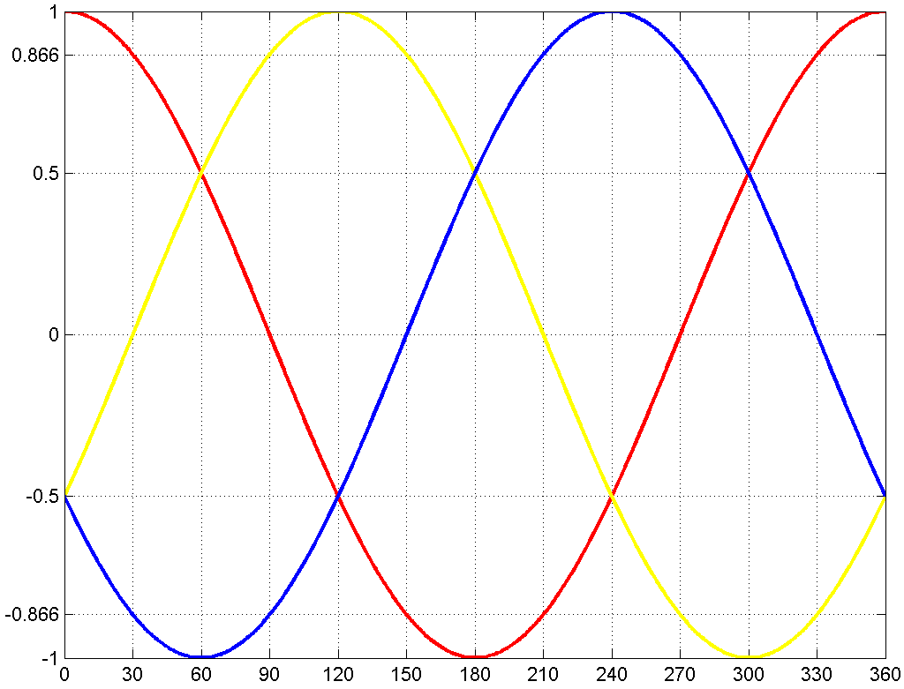
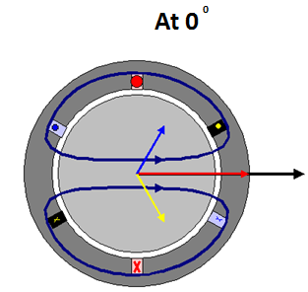
Rotating Magnetic Field

Slide 14
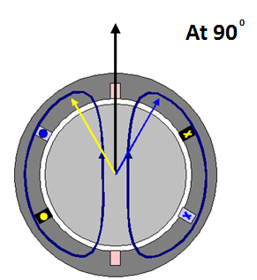
Rotating Magnetic Field

Slide 15
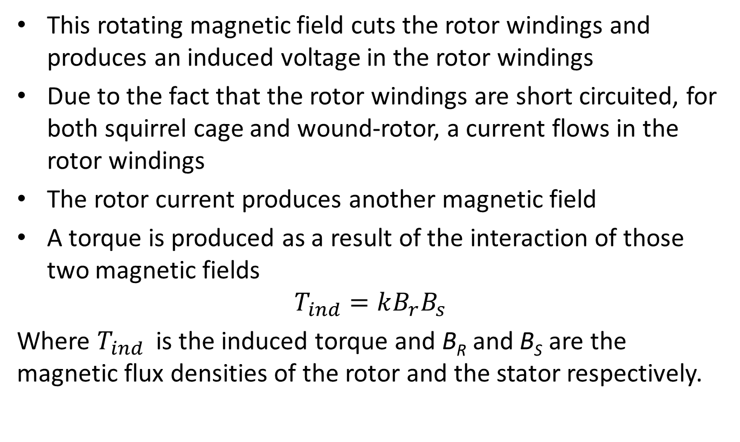
Principle of operation
This rotating magnetic field cuts the rotor windings and produces an induced voltage in the rotor windings
Due to the fact that the rotor windings are short circuited, for both squirrel cage and wound-rotor, a current flows in the rotor windings
The rotor current produces another magnetic field
A torque is produced as a result of the interaction of those two magnetic fields
$$T_{ind}=kB_{r}B_{s}$$
Where $T_{ind}$ is the induced torque and B_{R} and B_{S} are the magnetic flux densities of the rotor and the stator respectively.

Slide 16
Induction Motor Speed
At what speed will the IM run?
  Can the IM run at the synchronous speed, why?
  If rotor runs at the synchronous speed, which is the same speed of the rotating magnetic field, then the rotor will appear stationary to the rotating magnetic field and the rotating magnetic field will not cut the rotor. So, no induced current will flow in the rotor and no rotor magnetic flux will be produced so no torque is generated and the rotor speed will fall below the synchronous speed
  When the speed falls, the rotating magnetic field will cut the rotor windings and a torque is produced

Slide 17



Induction Motor Speed
So the Induction motor always run at a speed lower than the synchronous speed
The difference between the motor shaft speed and the synchronous speed is called the Slip

Slide 18
The Slip
Notice that : if the rotor runs at synchronous speed
s = 0
if the rotor is stationary
s = 1
Slip may be expressed as a percentage by multiplying the above eq. by 100, notice that the slip is a ratio and doesn’t have units

Slide 19
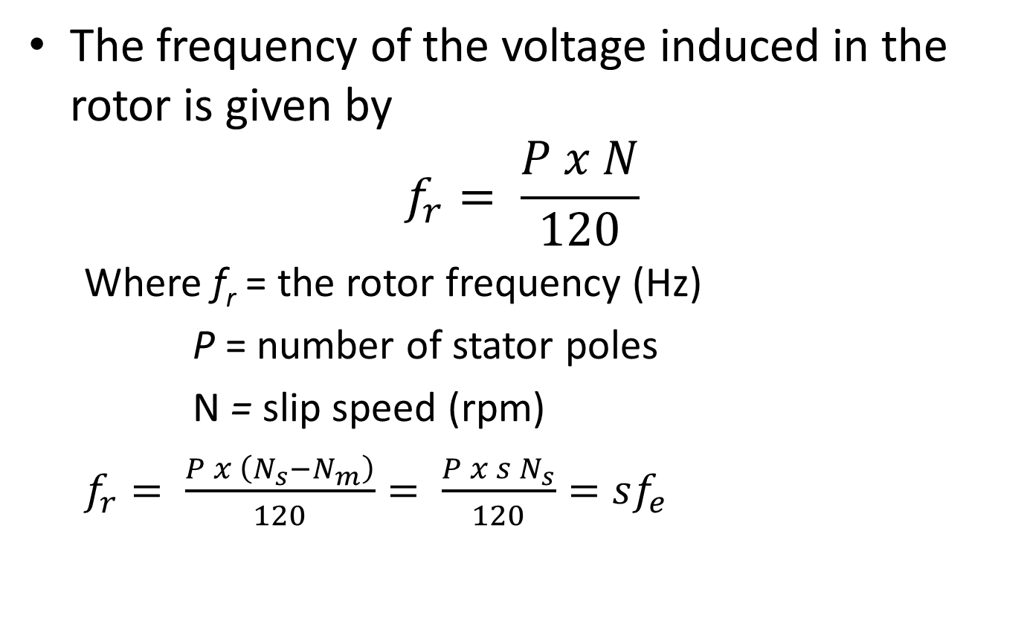
Frequency
The frequency of the voltage induced in the rotor is given by
$$f_{r}= \frac{P x N}{120}$$
  Where f_{r}= the rotor frequency (Hz)
  P = number of stator poles
  N= slip speed (rpm)
  $$f_{r}= \frac{P x \left(N_{s}−N_{m}\right)}{120}= \frac{P x s N_{s}}{120}=sf_{e}$$

Slide 20
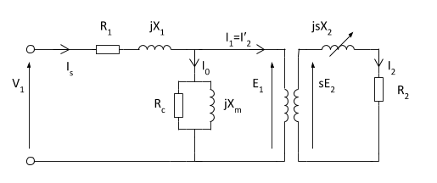
Equivalent Circuit of an IM
We can use the equivalent circuit of a transformer to model an induction motor.
R1 - Resistance of the stator winding
X1 Stator leakage reactance
Xm - Magnetising reactance required to cross the air gap
Rc - Core losses

Slide 21
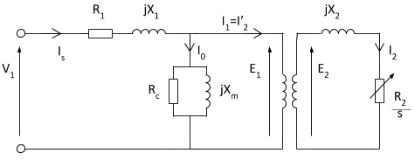
Equivalent Circuit of an IM- Modified

Slide 22
R₁ = Stator resistance per phase.
X₁ = Stator reactance per phase
V₁ = Stator voltage per phase has to counter balance self induced e.m.f. E₁ and has to supply voltage drops I₁ R₁ and I₁ X₁.
The rotor induced e.m.f. in the running condition has to supply the drop across impedances as rotor short circuited.

Slide 23
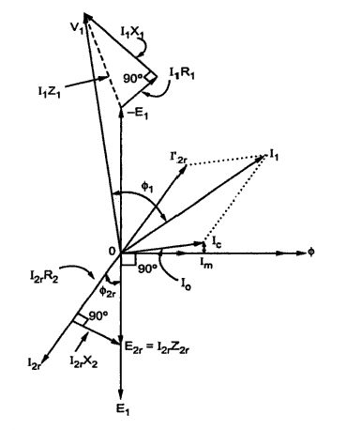
Phasor diagram of an Induction Motor

Slide 24
Starters- Squirrel Cage IM
Direct-On-line Starting
Stator Rheostat Starting
Autotransformer Starting
Star-Delta Starter

Slide 25
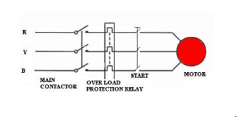
Direct On-Line(DOL) Starter
Used for motors upto 2 kW
Starting torque about twice the full load torque

Slide 26
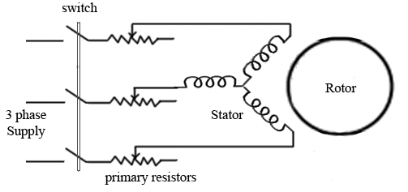
Stator Rheostat Starter
Advantages: High PF during start, Less Expensive, Smooth acceleration
Disadvantages: Losses in Resistors, Low torque efficiency

Slide 27
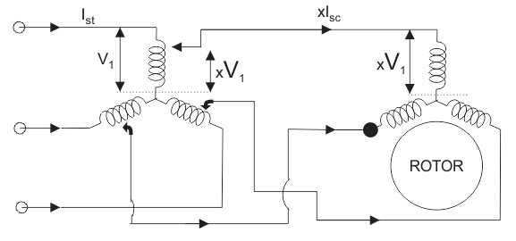
Auto-Transformer Starter
Advantages: High torque/Ampere, Long starting period, Can be used for star and delta connected motors,
Disadvantages: Low PF (Lagging), Higher cost

Slide 28
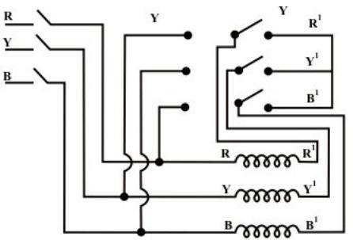
Star-Delta Starter
Reduced starting current but the starting torque is also reduced by the same amount
Limited to applications where high starting torque is not necessary

Slide 29
Starters- Slip Ring IM
Rotor Rheostat
Autotransformer Starting
Star-Delta Starter

Slide 30
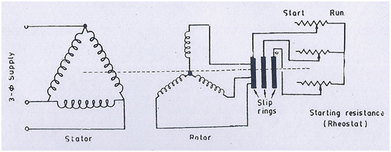
Rotor Rheostat Starter for Slip Ring IM
By increasing rotor resistance, the rotor current is reduced at starting. The torque is increased due to improvement in PF
Such motors can be started under load

Slide 31
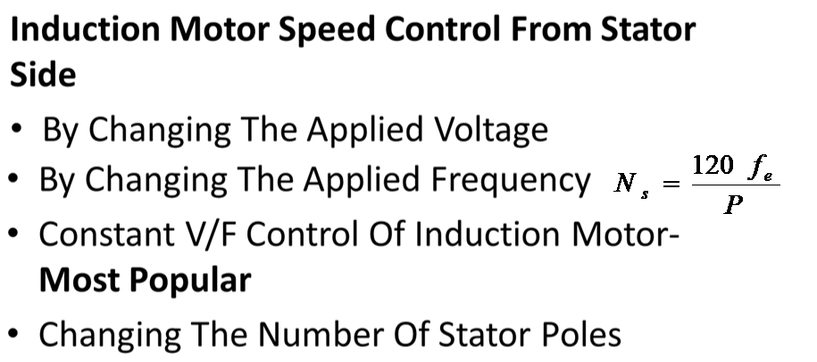
Speed Control Methods of IM

Slide 32
Constant V/F Control Of Induction Motor
If the supply frequency is reduced keeping the rated supply voltage, the air gap flux will tend to saturate causing excessive stator current and distortion of the stator flux wave.
If the ratio of voltage to frequency is kept constant, the flux remains constant. Also, the developed torque remains approximately constant.

Slide 33
Speed Control Methods Of IM …..
Induction Motor Speed Control From Rotor Side
Rotor Rheostat Control
Cascade Operation
By Injecting EMF In Rotor Circuit: By changing the phase of injected emf, speed can be controlled

Slide 34
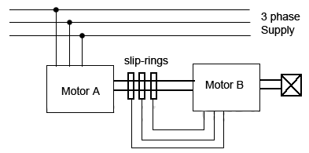
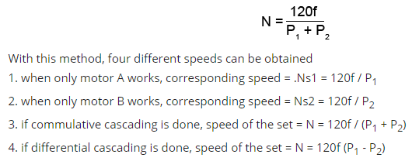
Cascade Operation

