Slide 1

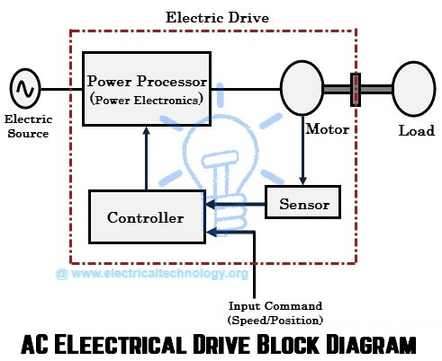
EE305 Power Electronics
Dr. Unnikrishnan P.C.
Professor, EEE
http://people.rajagiritech.ac.in/unnikrishnanpc/classes/2017-odd-semester-power-electronics

Slide 2
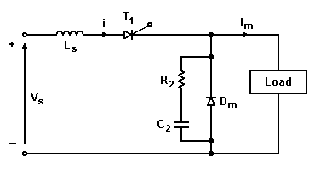
di/dt Protection
di/dt is limited by adding a series inductor L_{s} .
The forward di/dt is

Slide 3
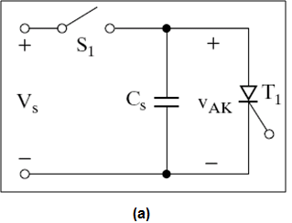
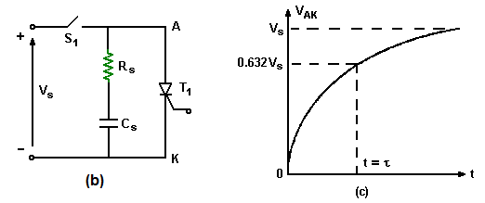
dv/dt Protection- Snubber Circuit
The dv/dt across the Thyristor is limited by using a circuit as shown in fig.(a). If switch is closed at t=0 , the rate of rise of voltage across the Thyristor is limited by the capacitor . When Thyristor is turned on, the discharge current of the capacitor is limited by the resistor shown in fig.(b). V_{s} rises exponentially

Slide 4
dv/dt Protection….Cont….
The snubber time Constant
is determined from equation (1) for a known value of dv/dt.The value of R_{s} is found from the discharge current I_{TD}

Slide 5
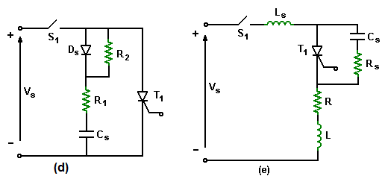
dv/dt Protection….Cont….
dv/dt limited by R₁ and C_{s} . (R₁ + R₂) limits the discharging current I_{TD.}

Slide 6
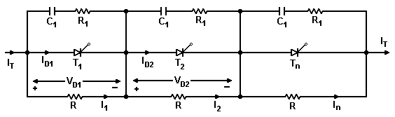
Series operation of Thyristors
  Thyristors connected in series to provide voltage rating in HV applications
  Each thyristor in the network should share reverse blocking and forward blocking voltages

Slide 7
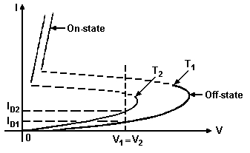
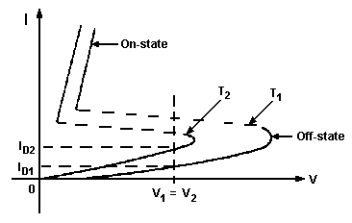
Unequal distribution of voltage across two series SCRs.
Off State Characteristics of two Thyristors
Forward Leakage Currrents with equal voltage sharing

Slide 8
Let there be ns thyristors in the string
Offstate current of T₁ is I_{D1} and I_{D2}=I_{D3}=I_{DN} and I_{D1}<I_{D2}
T1 has least offstate current, so it shares higher voltage.
During Turn-Off, differences in stored charge caused differences in reverse voltage sharing.
The thyristor with least t_{rr} faces the highest transient voltage
The snubber circuit limits the discharge current and helps transient voltage sharing.

Slide 9
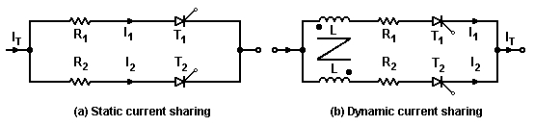
Parallel Operation of Thyristor
If a thyristor carries more current, its power dissipation increases leading to thermal runaway- need common heat sink
Small resistances connected in series force equal current sharing- introduces power loss
Magnetically coupled inductors solve problem. If I₁ increases, a voltage of opposite polarity induced in windings of T₂, reducing impedance of path T₂, thereby increasing I₂

