Slide 1

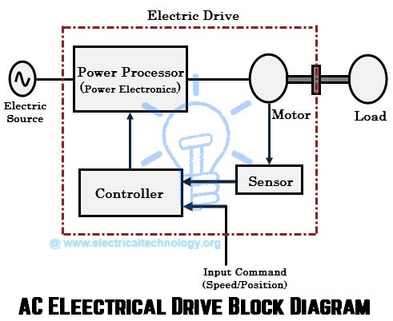
EE305 Power Electronics
Dr. Unnikrishnan P.C.
Professor, EEE

Slide 2
Disadvantages with 1-phase converters
Used in low power applications rarely exceeding 5 KW
Large output voltage and current form factor.
Large low frequency harmonic ripple current causing harmonic power loss and reduced efficiency.
Very large filter capacitor for obtaining smooth output dc voltage.
Low frequency harmonic current is injected in the input ac line which is difficult to filter. The situation becomes worse with capacitive loads.

Slide 3
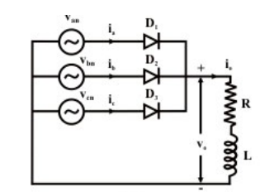
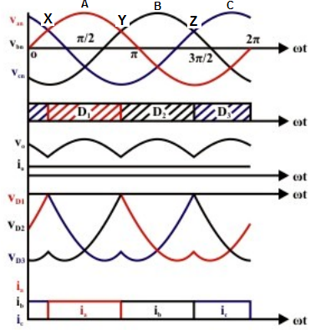
3-phase half wave uncontrolled rectifier
Common Cathode Configuration, Device with the largest cathode voltage will conduct.
X,Y,Z are points of natural commutation
Each device conducts for 120°
Three pulse converter
When any device conducts, the load voltage is its phase voltage

Slide 4
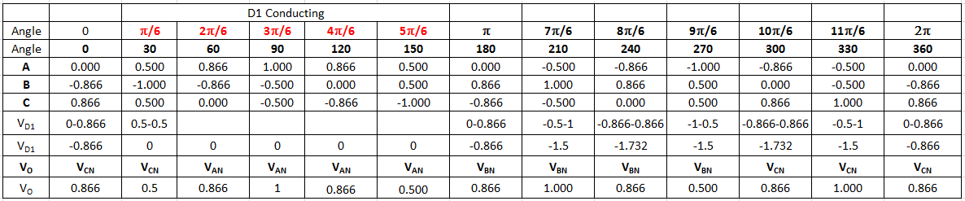
Finding Voltage across D₁ & V_{O}

Slide 5
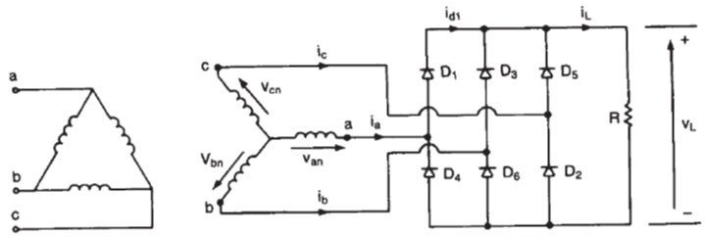
3-phase Full wave uncontrolled rectifier
Circuit diagram

Slide 6
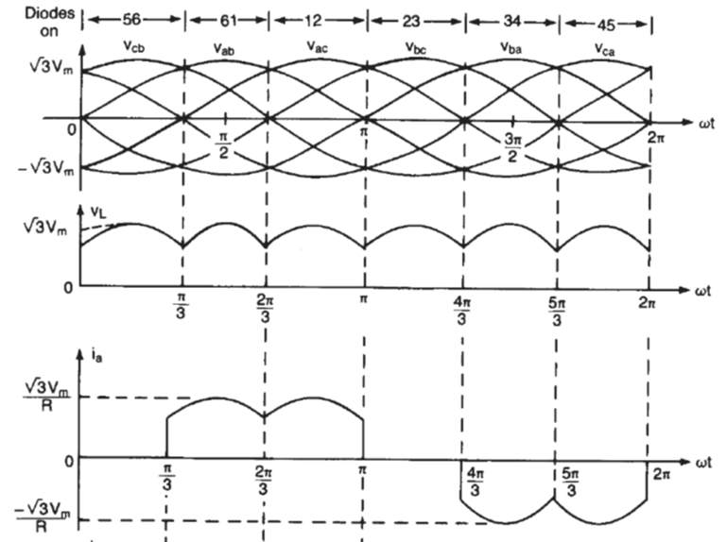
3-phase Full wave uncontrolled rectifier
Waveforms

Slide 7
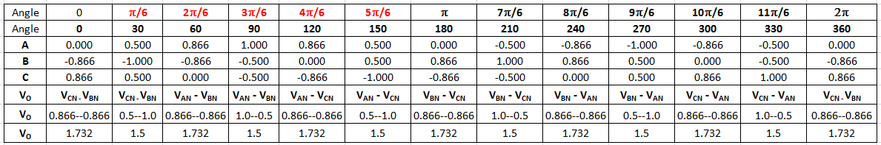
Voltage across Load- V_{O}

