Slide 1

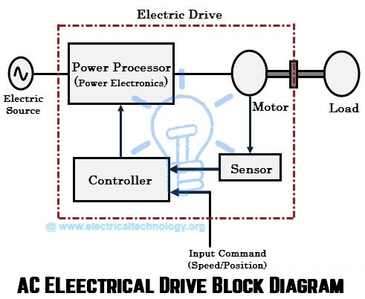
EE305 Power Electronics
Dr. Unnikrishnan P.C.
Professor, EEE

Slide 2
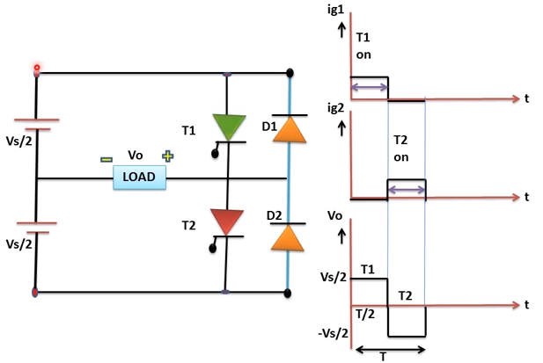
Single Phase Half Bridge Inverter

Slide 3
Single Phase Half Bridge Inverter-R Load
Average Power delivered to the load

Slide 4
Single Phase Half Bridge Inverter-R Load
Performance Parameters
Harmonic Factor: Ratio of the RMS value of the n^{th} harmonic voltage to the RMS value of the fundamental voltage
Total Harmonic Distortion: Ratio of the RMS value of the voltage excluding the fundamental voltage to the fundamental voltage

Slide 5
Single Phase Half Bridge Inverter-R Load
Performance Parameters
Distortion Factor: Indicates the amount of harmonic distortion associated with a particular waveform after the harmonics of that waveform have been subjected to a second order attenuation or divided by n².
Lower Order Harmonics: The harmonic component whose frequency is closest to the fundamental one and the amplitude is greater than or equal to 3% of the fundamental component

Slide 6
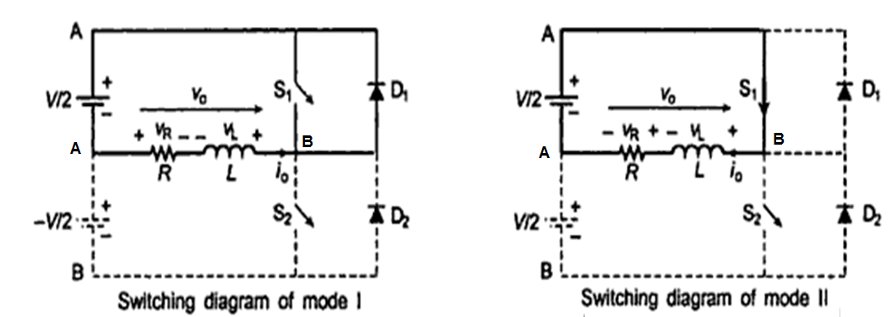
Single Phase Half Bridge Inverter RL Load
Diode D₁ Conducts 0 < t < t₁
S1 turned ON t₁ < t < T_{S}/2

Slide 7
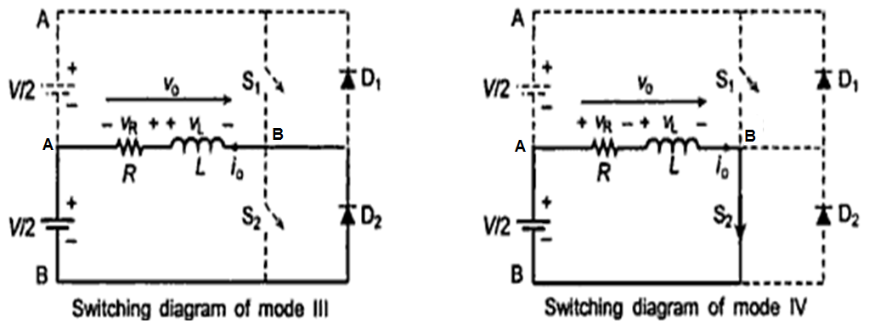
Single Phase Half Bridge Inverter RL Load
Diode D₂ Conducts T_{S}/2 < t < t₂
S2 turned ON t₂ < t < T_{S}

Slide 8
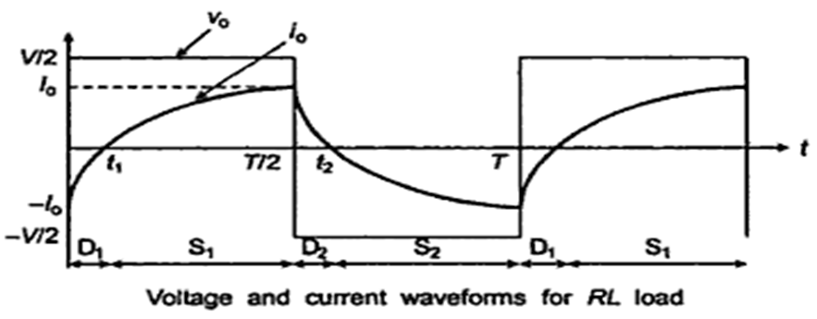
Single Phase Half Bridge Inverter RL Load

Slide 9
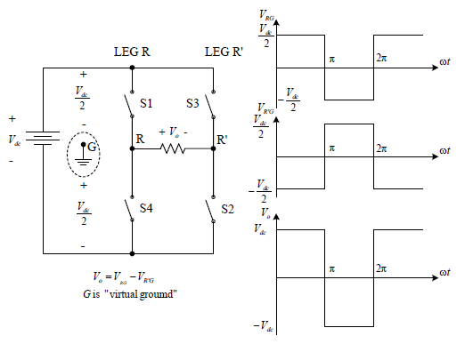
Single Phase Full Bridge Inverter RL Load
Full bridge is built from two half-bridge leg.
The switching in the second leg is “delayed by 180 degrees” from the first leg.

Slide 10
Single Phase Full Bridge Inverter RL Load
Mode 1: Diode D₁ & D₂ Conducts 0 < t < t₁
Mode 2: S1 & S2 are turned ON t₁ < t < T_{S}/2
Mode 3: Diode D₃ & D₄ Conducts T_{S}/2 < t < t₂
Mode 2: S3 & S4 are turned ON t₂ < t < T_{S}

Slide 11
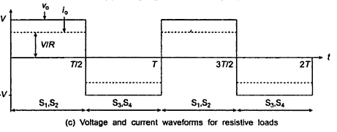
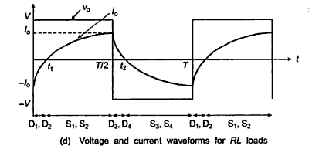
Single Phase Full Bridge Inverter R & RL Loads

Slide 12
Single Phase Full Bridge Inverter-R Load
Average Power delivered to the load
RMS value of the nth harmonic Voltage

Slide 13
Single Phase Full Bridge Inverter-R Load
Performance Parameters
Harmonic Factor:
Total Harmonic Distortion:
Distortion Factor:

