Slide 1

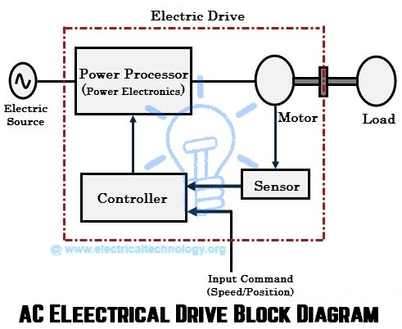
EE305 Power Electronics
Dr. Unnikrishnan P.C.
Professor, EEE

Slide 2
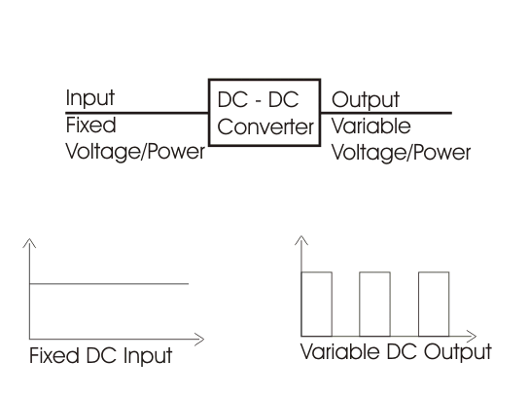
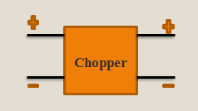
Choppers

Slide 3
What is a Chopper?
Converter that converts a constant DC voltage to a variable DC voltage
Also known as DC-DC converter
Done by switching the source ON and OFF periodically
Widely used in trolley cars, battery operated vehicles, traction motor control, control of large number of dc motors, etc…

Slide 4
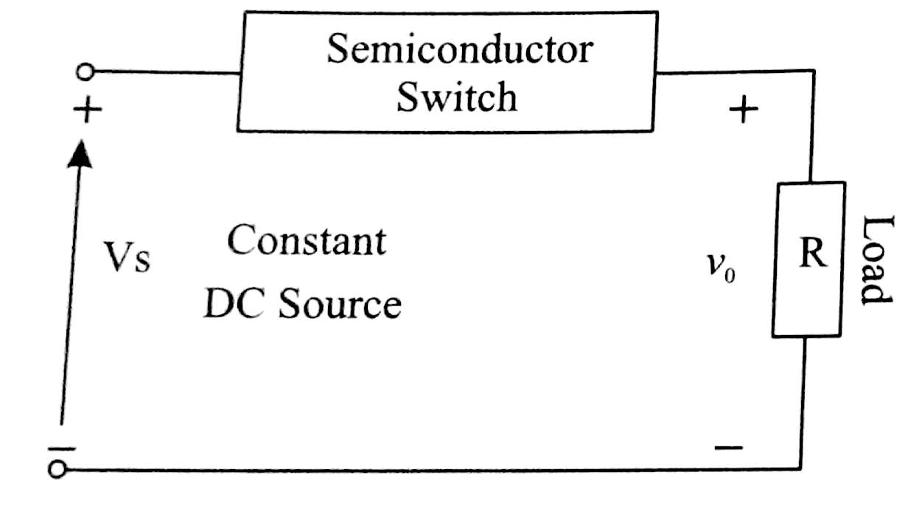
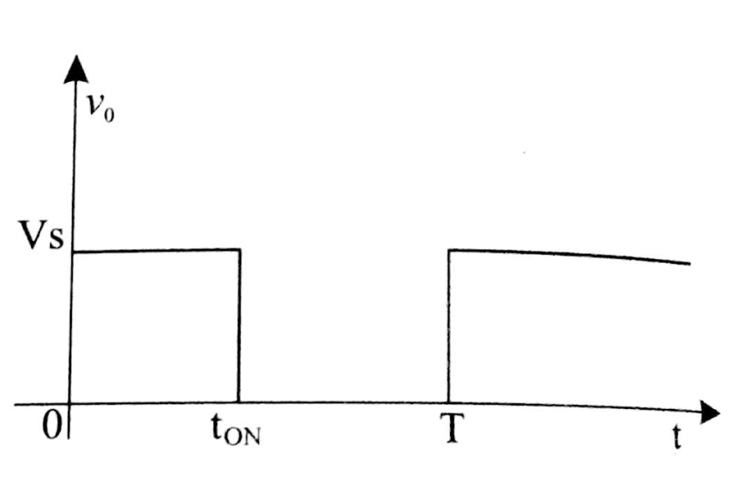
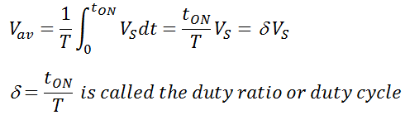
Step down chopper
Principle of Operation
t_{ON}- ON time of switch and
t_{OFF}- OFF time of switch
The average output voltage:

Slide 5
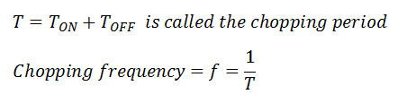

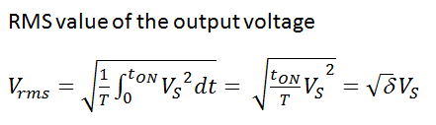
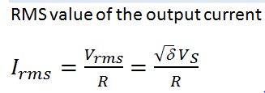
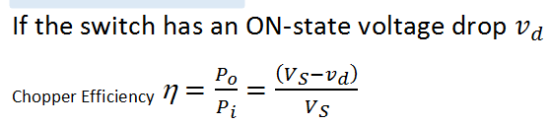
Step down chopper
Average value of the load current for resistive load

Slide 6
Control of Output Voltage
Time Ratio control(TRC)
For the control of output voltage two methods
  Constant frequency TRC
  Variable frequency TRC
    Constant t_{ON}
    Constant t_{OFF}

Slide 7
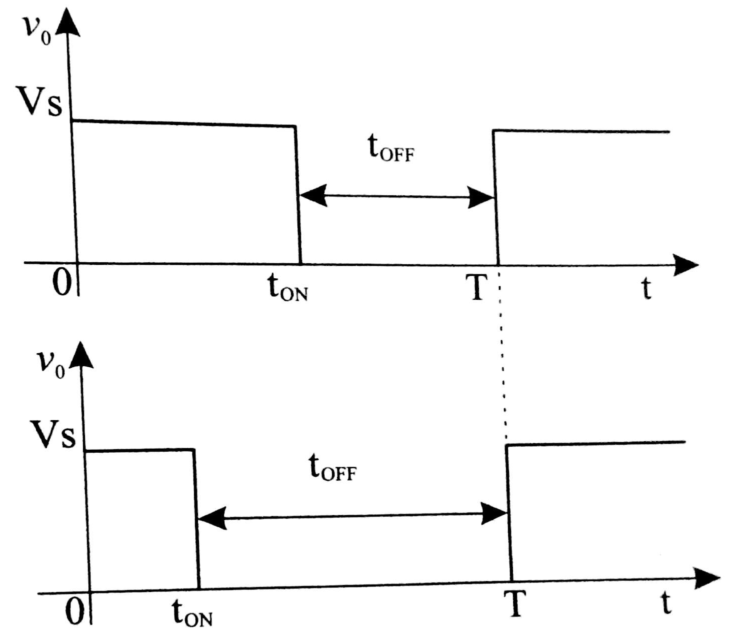
Constant frequency TRC
Also Called “pulse width modulation scheme”
Chopping frequency kept constant and t_{ON} varied

Slide 8
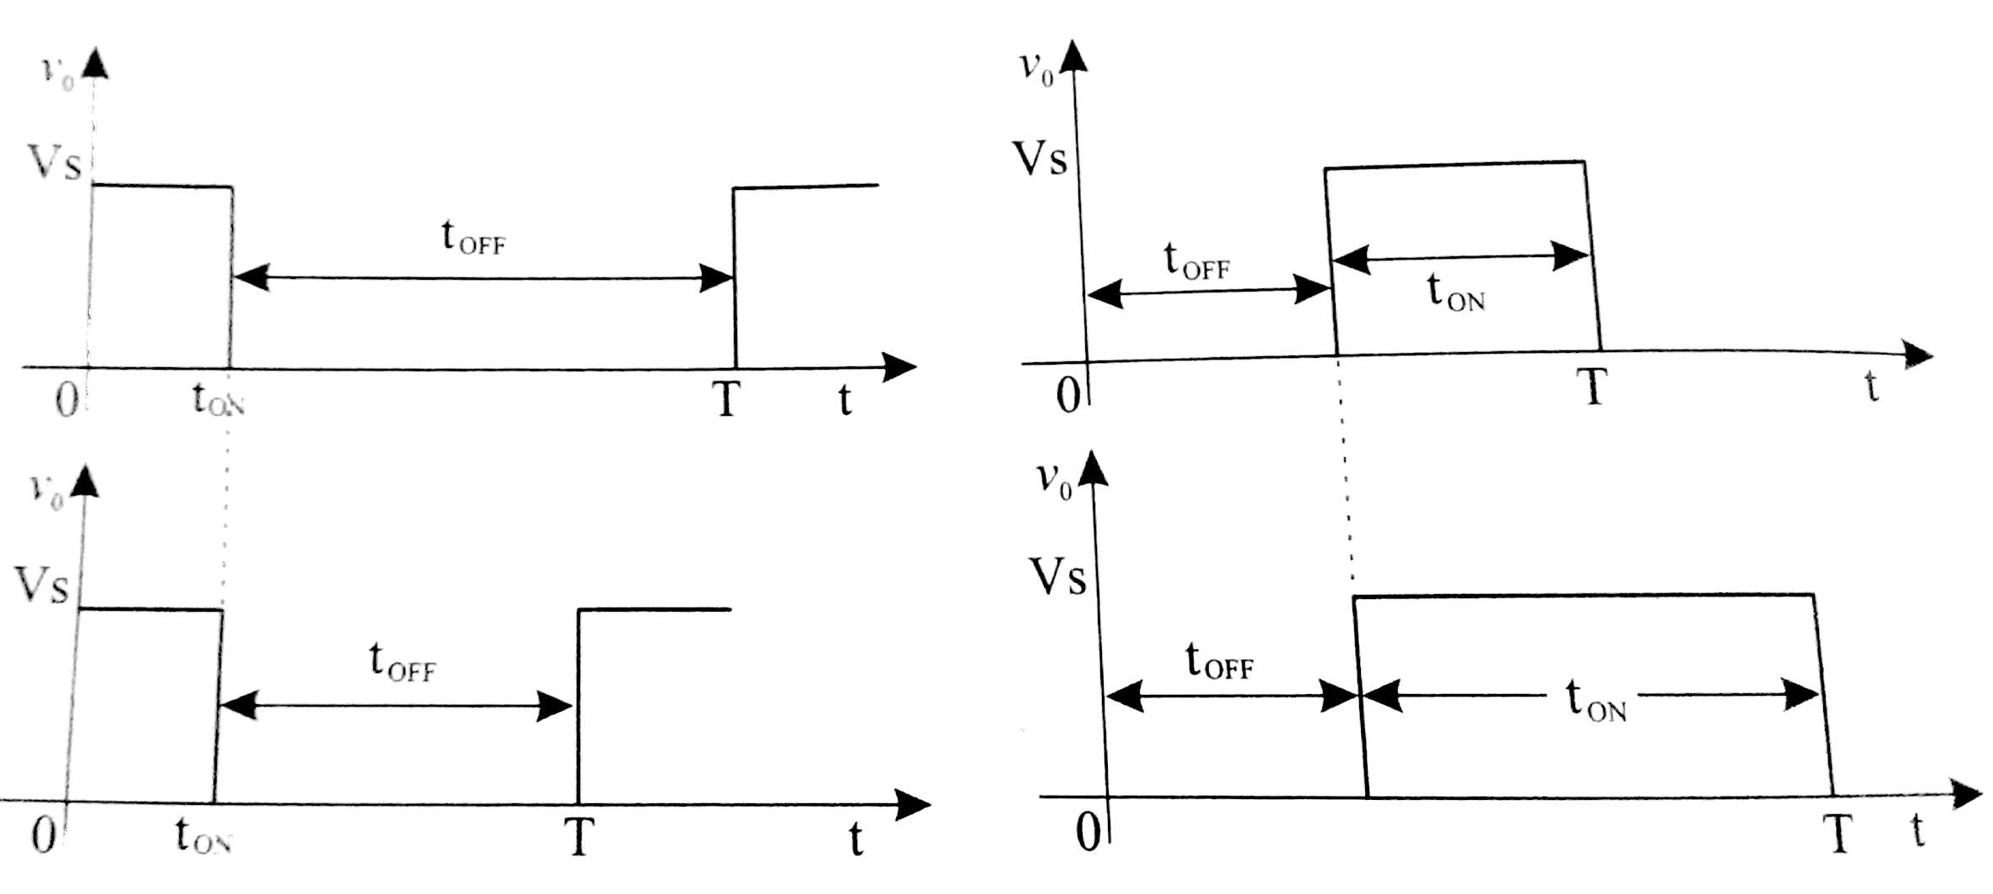
  Variable frequency TRC(Constant t_{on})
  Also called “frequency modulation scheme”
Keeping t_{ON} constant and varying t_{OFF} i.e. Varying f

Slide 9
  Variable frequency TRC(Constant t_{off})
  Also called “frequency modulation scheme”
Keeping t_{OFF} constant and varying t_{ON} i.e. Varying f

Slide 10
  Variable frequency TRC
Disadvantages:
Generates harmonics of different frequencies and hence requires large filters
To control the duty cycle,δ, frequency variation would be wide. This might create interference with signalling and telephone lines.
The large OFF-time in this scheme may make the load current discontinuous which is undesirable.
A fixed frequency Chopper is generally used

Slide 11
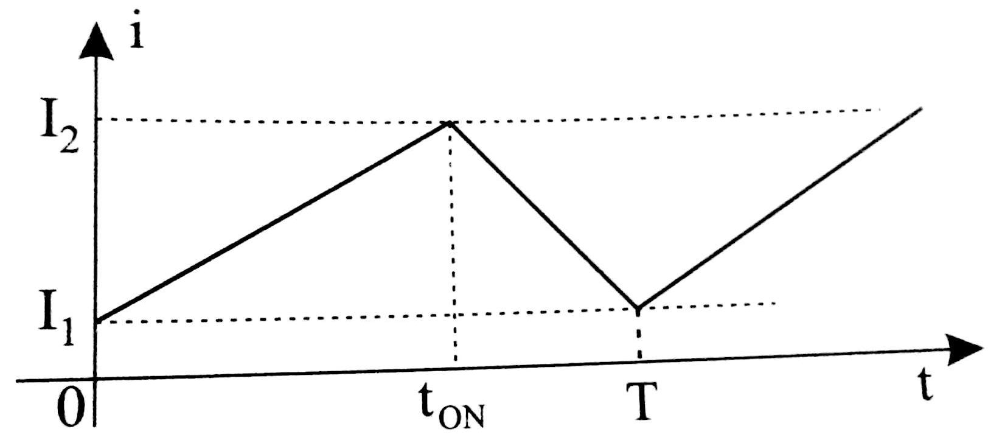
Current limit control
Load current maintained between an upper level and lower level.
When the load current reached the upper limit, the chopper switch is turned OFF, the load current decays to the lover limit through a free wheeling diode. The load current is continuous- possible only with high inductive loads

Slide 12
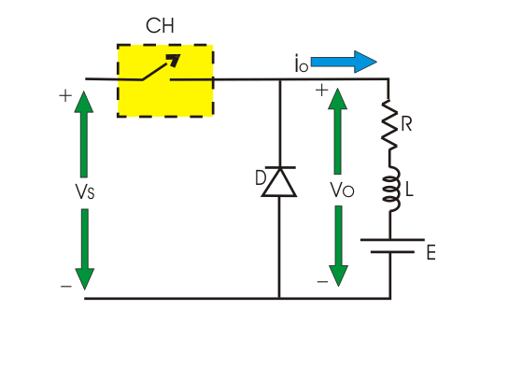
Step-Down Chopper

Slide 13
Step-Down Chopper
Chopper Switch kept ON for t_{ON} and the energy is stored in the inductor
As the switch is turned OFF, the free wheeling diode is forward biased and the load current continues to flow due to the energy stored in the inductor.
The chopper switch is turned ON when load current reaches a lower limit
Load voltage and load current are positive and the power flows from the source to the load. So it is also called a first quadrant chopper or class A chopper

Slide 14
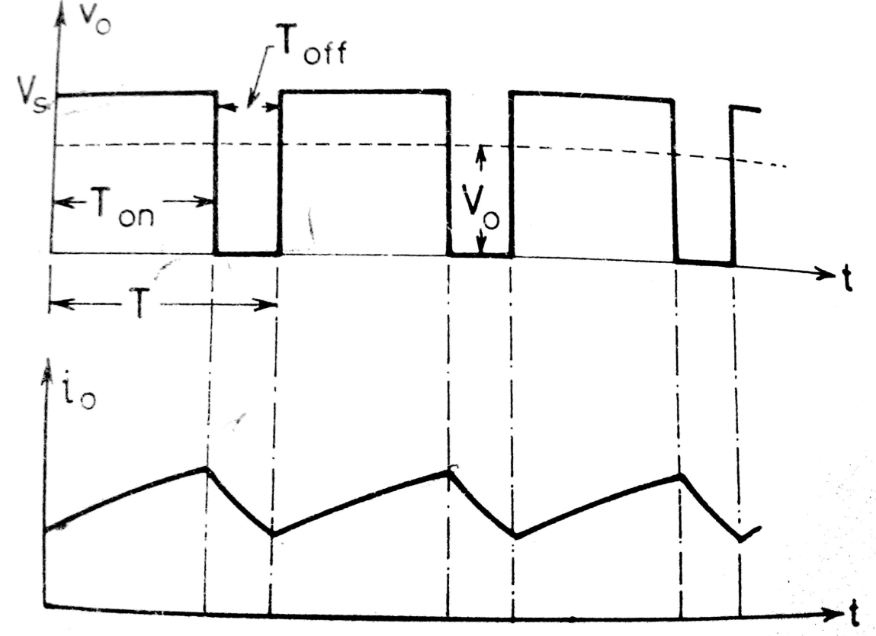
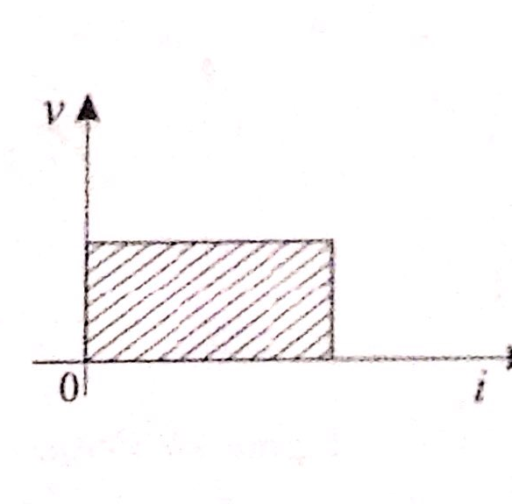
Step-Down Chopper

