Slide 1

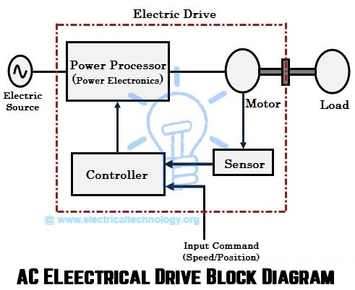
EE305 Power Electronics
Dr. Unnikrishnan P.C.
Professor, EEE

Slide 2
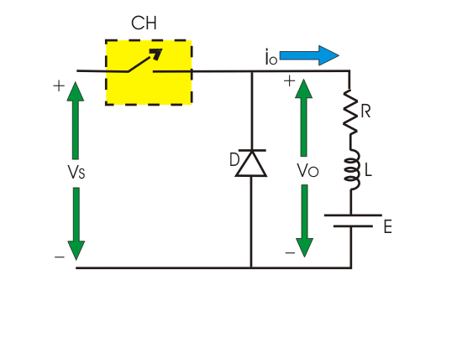
Step-Down Chopper

Slide 3
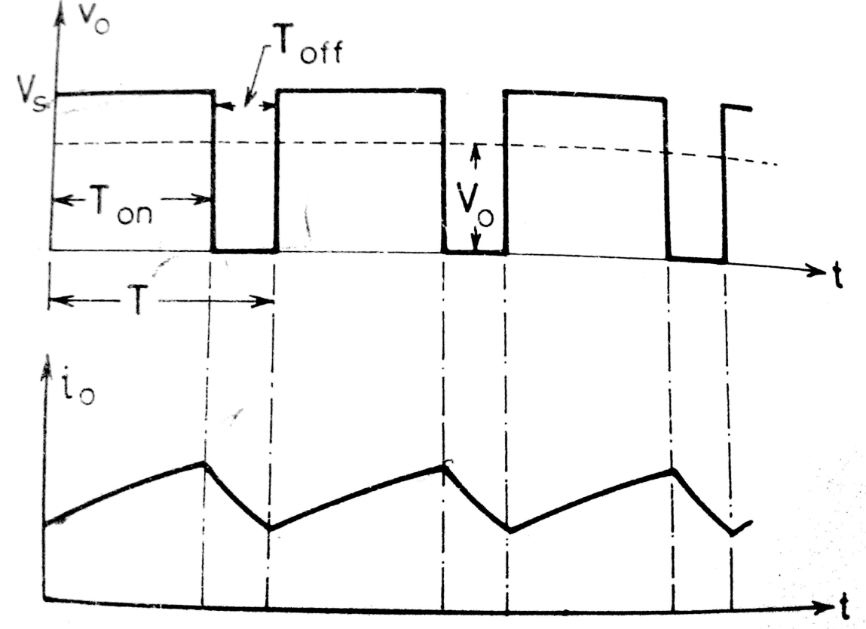
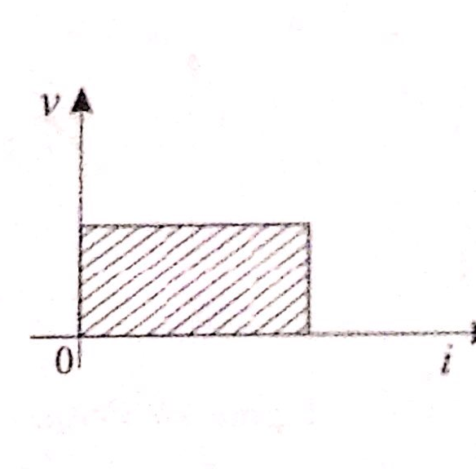
Step-Down Chopper

Slide 4
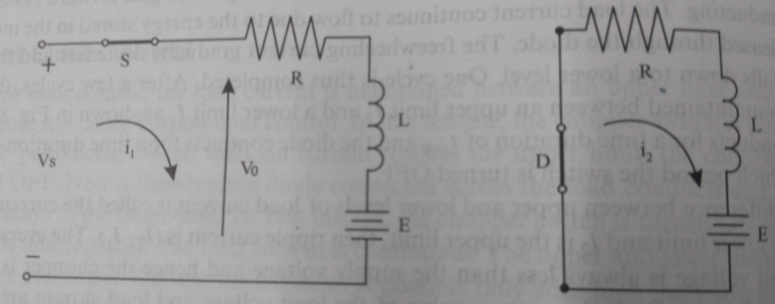
Analysis- Continuous Current
Chopper S is turned ON
Diode Conducts

Slide 5
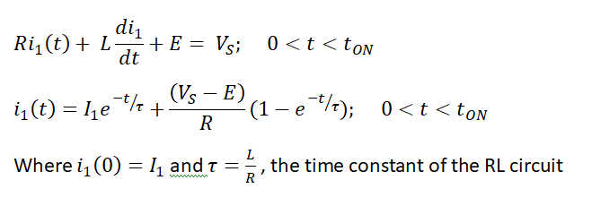
Analysis- Continuous Current
Mode 1: The Chopper switch S is turned ON

Slide 6
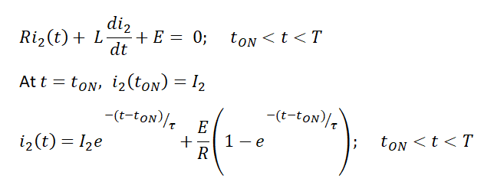
Analysis- Continuous Current
Mode 2: The Chopper switch S is turned OFF

Slide 7
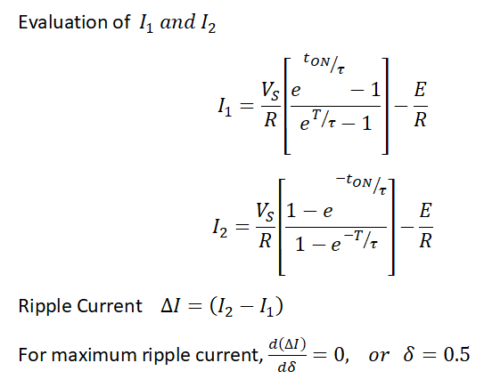
Analysis- Continuous Current
The ripple current is maximum when the duty cycle is 50%

Slide 8
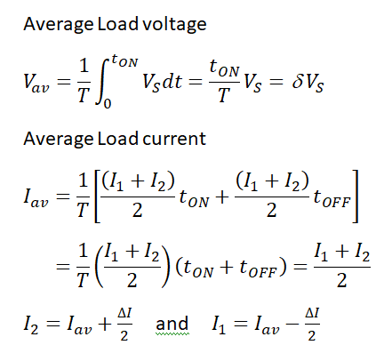
Analysis- Continuous Current

