Slide 1
Research Methodology
Dr. Unnikrishnan P.C.
Professor, EEE

Slide 2
Dr. Unnikrishnan P.C.
BTech. : EEE, NSS College of Engineering, 1981-85.
MTech: Control & Instrumentation, IIT Bombay,1990-92.
PhD. : EEE, Karpagam University, Coimbatore, 2010-2016.

Slide 3
Dr. Unnikrishnan P.C.
1986-1996 : Assistant Professor and Associate Professor, Rajasthan Technical University, Kota, India
1996-2016 : Assistant Professor, Academic Coordinator, Registrar, Head of Section and Head of the Department at Colleges of Technology, Ministry of Manpower, Muscat, Sultanate of Oman.
2016 - : Professor, EEE, RSET

Slide 4
Module IV
Meaning of interpretation and inference

Slide 5
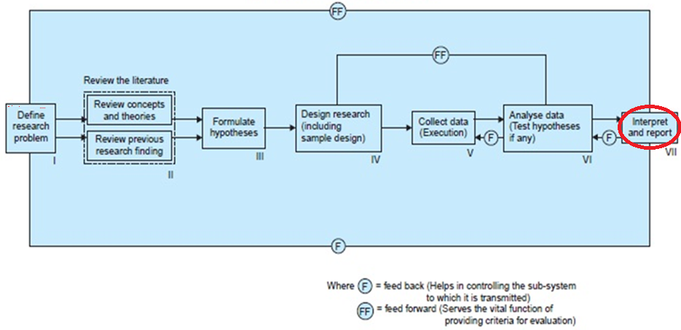
Research Process
Step VII. Interpret and Report

Slide 6
VII(a). Generalizations and interpretation:
If a hypothesis is tested and upheld several times, it may be possible for the researcher to arrive at generalization
Interpretation: If the researcher had no hypothesis to start with, he might seek to explain his findings on the basis of some theory.

Slide 7
VII(b). Preparation of the report or the thesis:
The layout of the report should be as follows: (i) the preliminary pages; (ii) the main text, and (iii) the end matter.
In its preliminary pages: title and date followed by acknowledgements and foreword in report. Then table of contents followed by a list of tables and list of graphs and charts

Slide 8
The main text of the report:(a) Introduction: clear statement of the objective of the research, an explanation of the methodology of research and the scope of the study along with various limitations
(b) Summary of findings: After introduction there would appear a statement of findings and recommendations in non-technical language. If the findings are extensive, they should be summarized.

Slide 9
Step 7. Interpretation of results
If a hypothesis is tested and upheld several times, it may be possible for the researcher to come to generalization, that is to build a theory.
If there is no hypothesis to start with, the researcher may try to explain his findings based on some existing theory. This is called interpretation and this may lead to further research.

Slide 10
Critical issues to be considered while interpreting data and drawing inferences from findings in survey based research
1. Are you fully powered? Statistical power is a measure of the probability that a statistical test will reject a false null hypothesis or the probability of finding a significant result when there is really one (0.8 is ideal). Statistical power is largely determined by significance criterion(0.05,0.01), effect size and sample size.
2. Are your distributions in good shape? Characteristics of the distribution- normality and independence
3. Measurement error- Psychometrically sound instrument - valid and reliable
4. Multiple comparisons. If we make enough comparisons, one or some of the results will undoubtedly will be significant (Fishing)
5. Clinical significance- real value of research finding lies in its clinical or real world significance and not in the statistical significance

Slide 11
Contd………
6. Are there alternate explanations?- Randomization is the best way to obtain scientific control over the study and to rule out alternate explanations. Make sure that there are no systematic differences between the exptl groups or conditions, and that the only thing that varies is the independent variable that you are manipulating.
7. Are you confusing correlation with causation – Can we say cold temperature cause colds? Rock music leads to drug abuse? Eating ice-cream cause drowning?
8. How significant is your non-significance? Non-significant findings can be as important, if not more important, than significant ones. Common beliefs or expected outcomes can change with population and can’t be generalized.

Slide 12
In modelling research
The results are inferred from the model on which the research is done and traced back to the real world problem with assumptions and necessary transformations.

Slide 13
In algorithmic research
This type of research give optimal or near optimal solution as per the assumed transformation of the real life problem in to a form suitable for the algorithm. This solution should be inferred in such a way that it is possible to implement it to bring about the desired results for the real life situation.

Slide 14
Step 8. Validation of results
In modelling and algorithmic research, the results after interpretation must be validated by using past data.
Validation gives credibility of the results
If there is mismatch, assumptions and modelling exercise must be revisited the results are validated
In testing hypotheses, validity is built-in in the significance level. Inferences from research can act as guidelines for forming policies or bringing changes in the system for betterment.

Slide 15
Step 9. Preparation of report
Preliminary pages
Cover Page, Bonafide Certificate, Declaration, Table of Contents, List of Tables, List of Figures, List of Symbols and Abbreviations, Acknowledgement, Abstract
Main text
Introduction, Chapters
End matter
Conclusion, Scope for future work, References, List of Publications

Slide 16
Validity in research
Refers to the conceptual and scientific soundness of a research study.
Internal validity
External validity
Construct validity
Statistical conclusion validity

Slide 17
(c) Main report: The main body of the report should be presented in logical sequence and broken-down into readily identifiable sections.
(d) Conclusion: results of his research should be clearly and precisely. Final summing up

Slide 18
Report should be written in a concise and objective style in simple language avoiding vague expressions such as ‘it seems,’ ‘there may be’, and the like.
Charts and illustrations in the main report should be used only if they present the information more clearly and forcibly.
Calculated ‘confidence limits’ must be mentioned and the various constraints experienced in conducting research operations may as well be stated.

